Slide 1
FreshBasket: Scalable E-commerce Platform Deployment
with Flask on AWS EC2 and RDS
Project Created By:
1.VISWANATHAN S
2.VISHAAL M
3.VINOTHKUMAR R
4.VENKATESAN B

Slide 2

FreshBasket: Scalable E-commerce Platform Deployment with Flask on AWS EC2 and RDS
Welcome! We’ll explore the architecture and deployment of FreshBasket, a cloud-native e-commerce platform built with Flask, AWS EC2, and Amazon RDS. This project demonstrates how to leverage AWS services to create a robust and scalable platform.

Slide 3
Project Overview: FreshBasket E-Commerce
Problem
Solution
Build a scalable e-commerce platform for selling fruits and vegetables.
FreshBasket uses Flask for backend development, AWS EC2 for hosting, and Amazon RDS for database management.

Slide 4

AWS Infrastructure: Foundation for Scalability
1
AWS Account Setup
2
RDS Database Creation
Create an AWS account and log in to the management console.
Set up a relational database instance using Amazon RDS, choosing MySQL for this project.
3
EC2 Instance Setup
Launch an EC2 instance to host the Flask application.

Slide 5
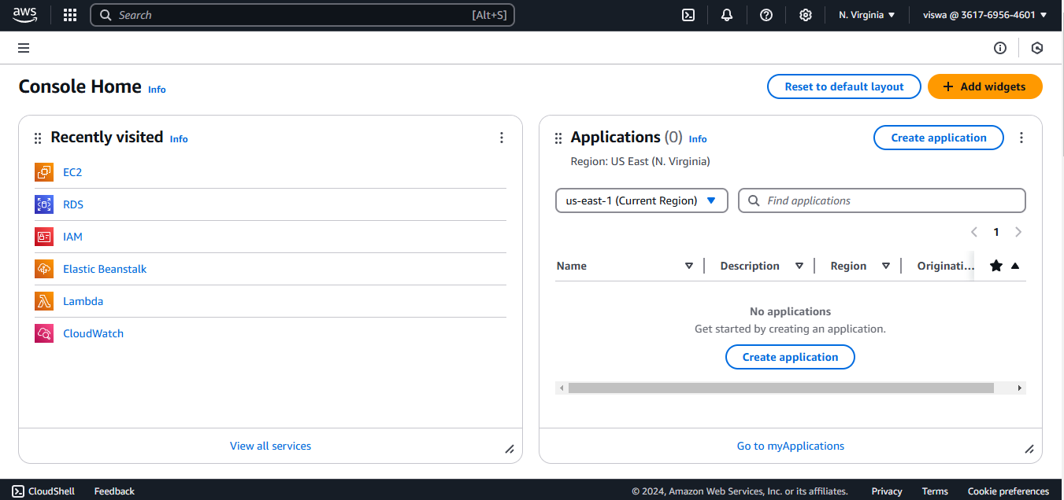
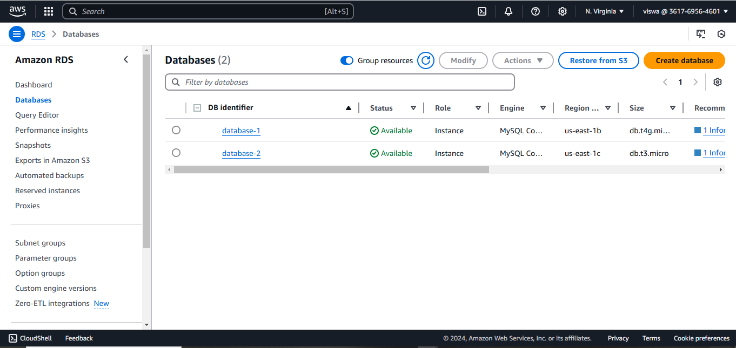
AWS Infrastructure: Foundation for Scalability:
Fig 1: AWS Account Setup
Fig 2: RDS Database Creation

Slide 6
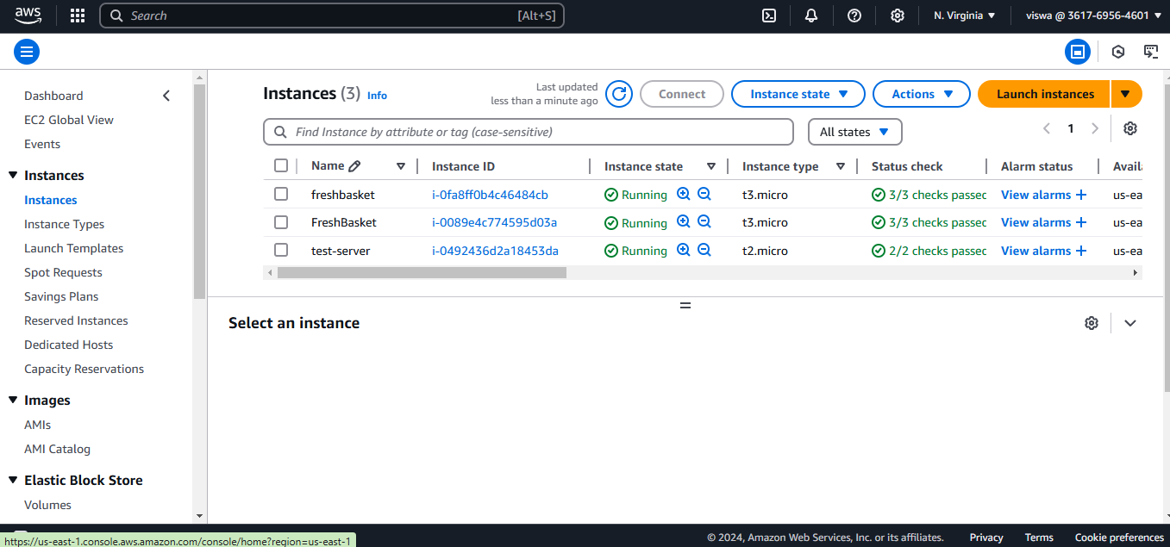
Fig 3: EC2 Instance Setup

Slide 7



Database Setup and Configuration
Database Creation
Database Access
Create the FreshBasket database and its necessary tables using MySQL Workbench.
Configure database access for the Flask application, ensuring secure connections.

Slide 8
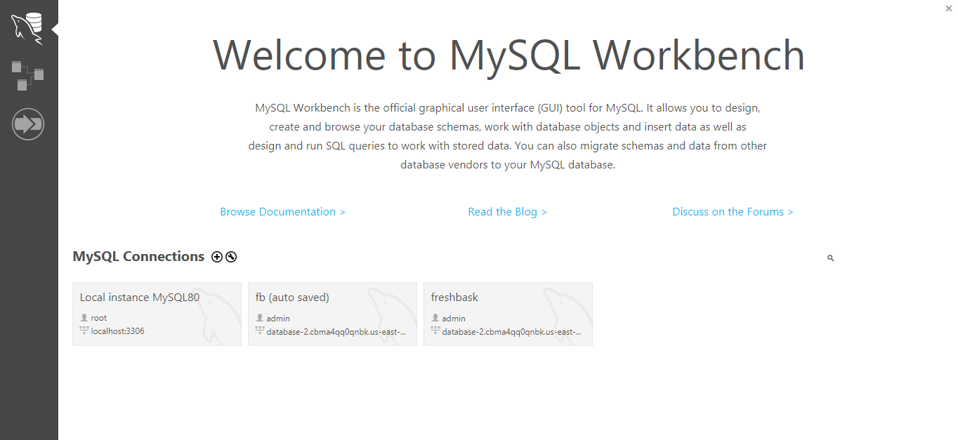
Database Setup and Configuration:
Fig 4: MySQL Workbench:

Slide 9
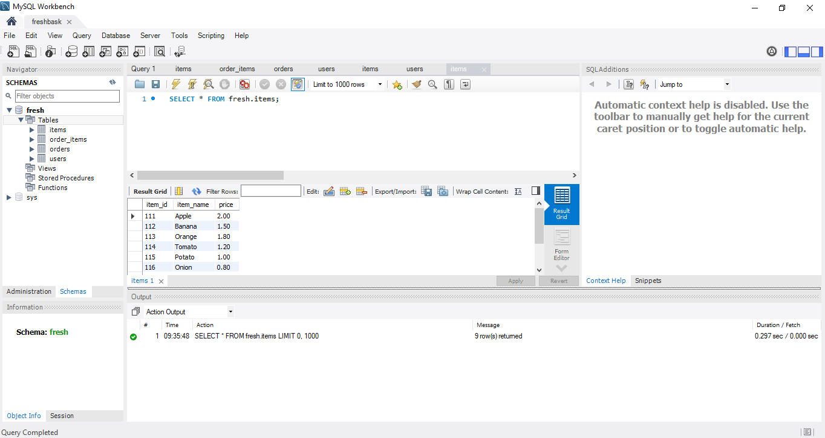
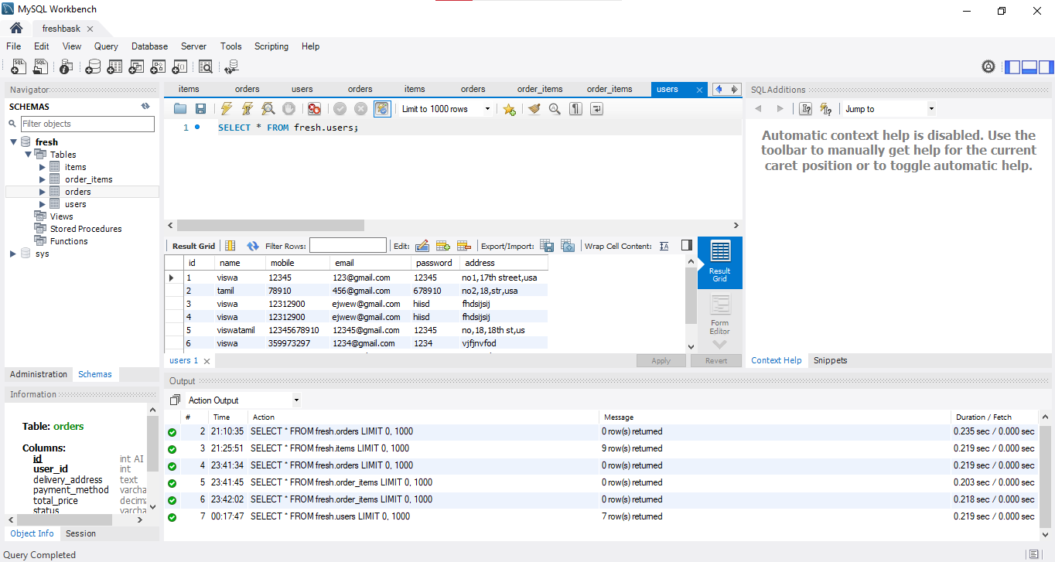
Fig 5: Cart Items
Fig 6: Table creation for users

Slide 10

Application Development and Deployment
1
Frontend Development
Develop the front-end user interface (UI) using HTML, CSS, creating a user-friendly shopping experience.
2
Flask Backend
Develop the Flask backend, integrating with the database to manage user interactions, product catalogs, and order processing.
3
Deployment
Deploy the Flask application onto the EC2 instance using a tool like MobaXterm for SSH access.

Slide 11
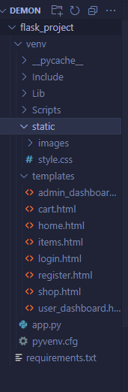
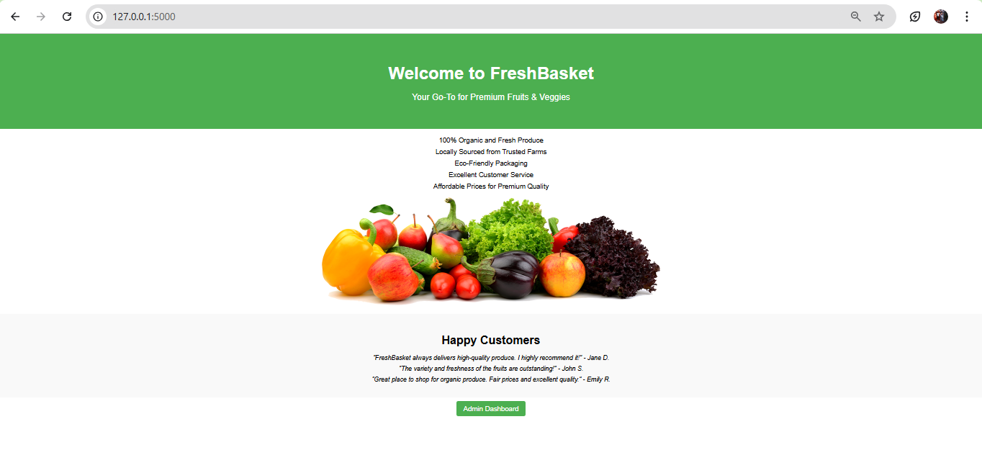
Fig 7: Home page

Slide 12
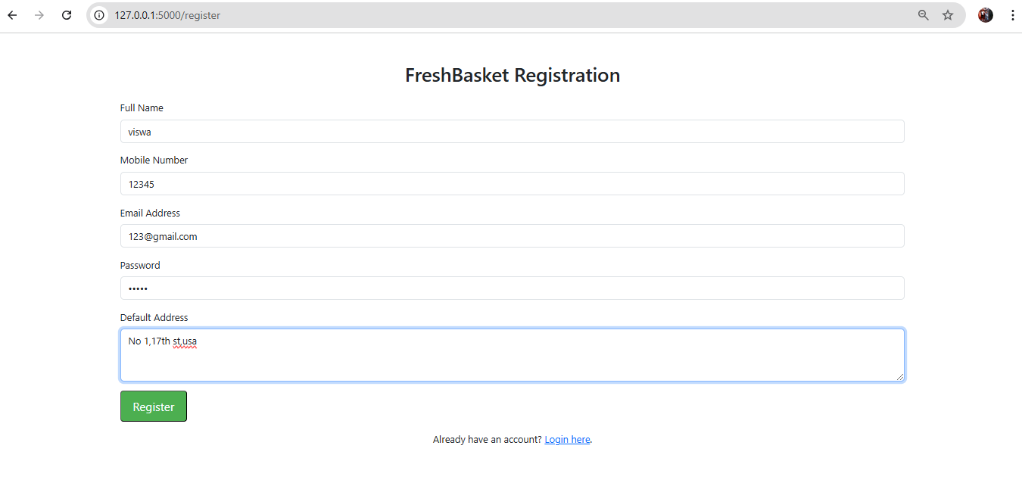
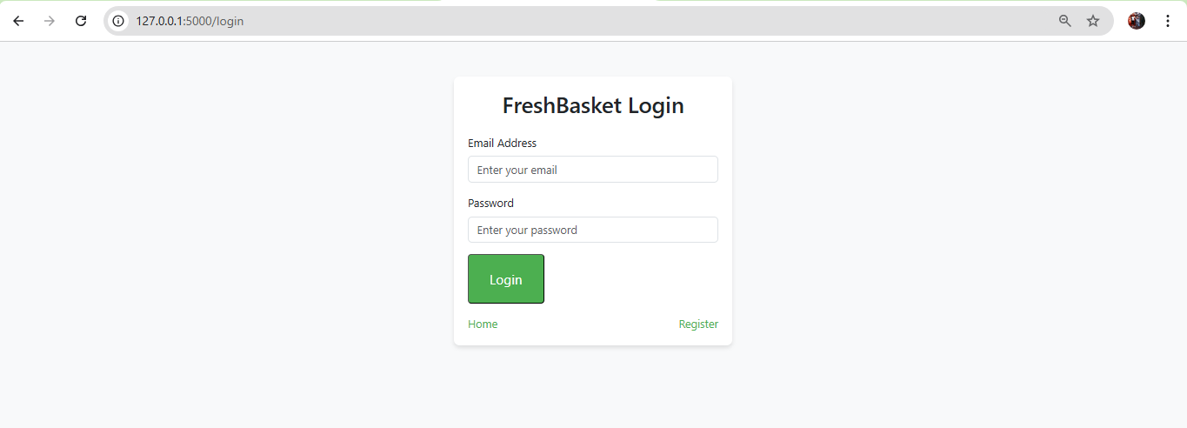
Fig 8: Register page if the user is new
Fig 9: Login page:

Slide 13
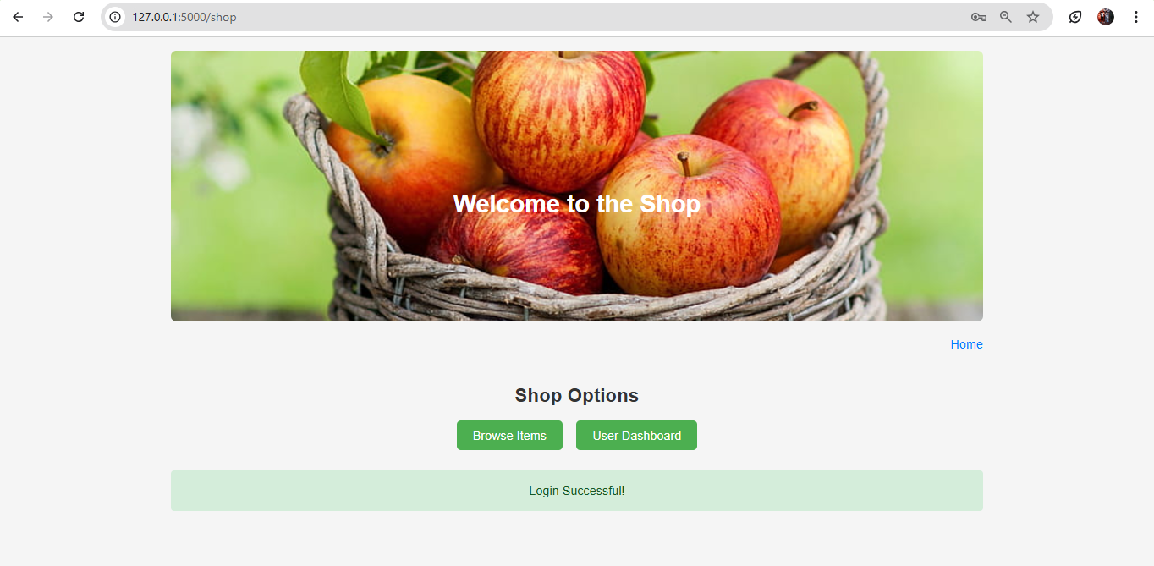
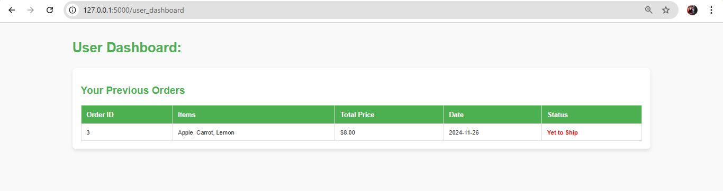
Fig 10: Product Browsing page
Fig 11:User dashboard

Slide 14
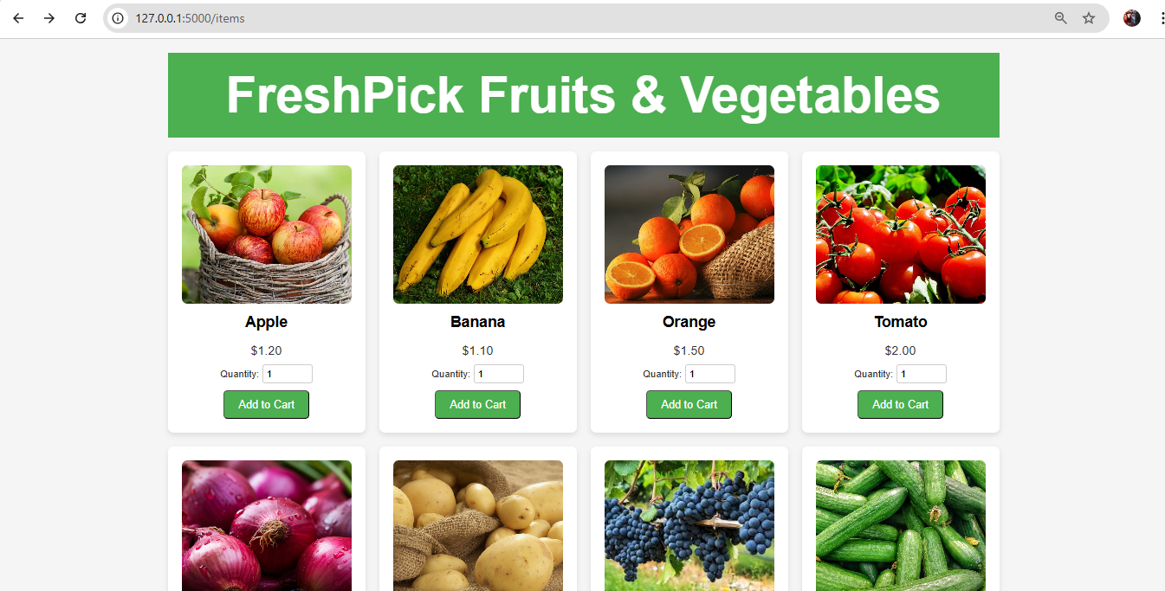
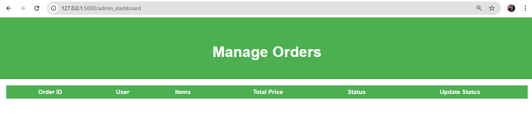
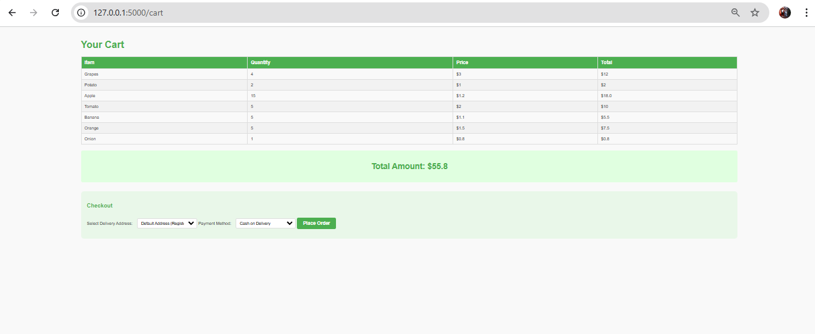
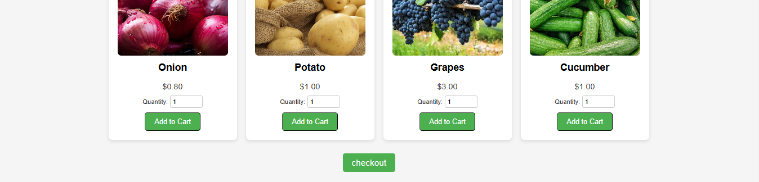
Fig 13: Admin dashboard
Fig 12: Items page
Fig 14: Cart

Slide 15
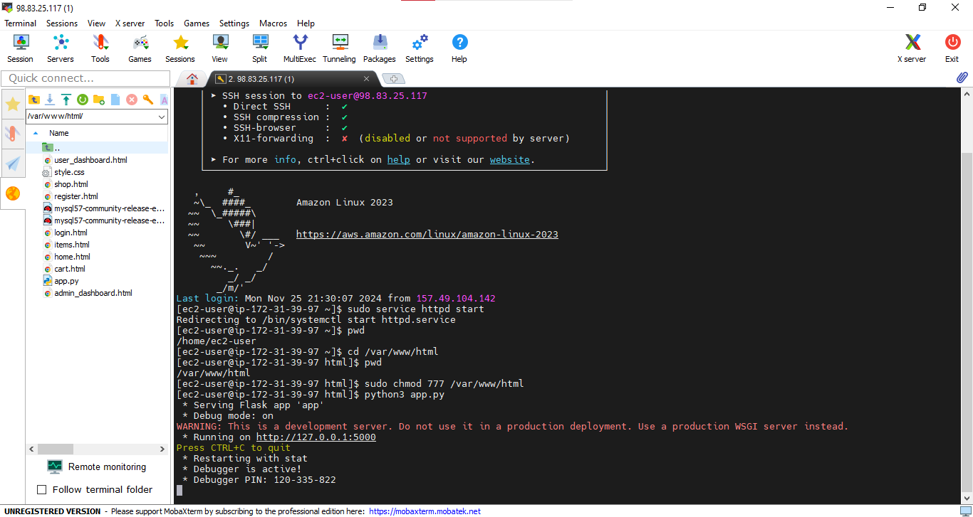
Fig 15: MobaXterm Setup and SSH Acces

Slide 16



Testing and Optimization
Functional Testing
1
Thorough testing of the FreshBasket platform to ensure it meets all requirements and performs flawlessly.
Performance Monitoring
2
Use AWS CloudWatch to monitor performance metrics and identify areas for optimization.
Optimization
3
Implement necessary optimizations to improve performance and efficiency.

Slide 17
Security and Scalability
Security Measures
1
Implement strong security measures to protect user data and ensure platform integrity.
Scalability Solutions
2
Implement auto-scaling and load balancing solutions on AWS EC2 to handle increased traffic.
Cloud-Native Architecture
3
Leverage cloud-native technologies and services for continuous integration and deployment (CI/CD).

Slide 18

Key Takeaways: FreshBasket Project
Scalable Architecture
Efficient Deployment
AWS services enable the creation of a scalable e-commerce platform.
Simplified deployment and management of the application on EC2.
Data Management
Amazon RDS ensures efficient and secure database operations.

Slide 19

Next Steps: Expanding FreshBasket
1
2
3
User Authentication
Payment Gateway
Mobile App
Integrate user authentication and authorization for secure access.
Integrate a secure payment gateway for processing orders.
Develop a mobile application for a seamless shopping experience.

Slide 20
References:
1. AWS Account Setup: https://youtu.be/CjKhQoYeR4Q?si=ui8Bvk_M4FfVM-Dh
2. Understanding of IAM: https://youtu.be/gsgdAyGhV0o?si=3qg-bULgkD4LXNvR
3. Knowledge of Amazon EC2: https://youtu.be/8TlukLu11Yo?si=MUj0nEAOESRhHUIz
4. Mobaxterm: https://youtu.be/dvoU2SKG6oA?si=Hs8Pu4Crry5-BRrD
5. RDS: https://www.youtube.com/live/MPau9c7PT74?si=A8OK-zFGbSKkAFWN 6. MySQL Workbench: https://youtu.be/wALCw0F8e9M?si=ovMF9qMx5rLxaznB

